Slide 1
Pictures for Church Building
4/26/2025

Slide 2
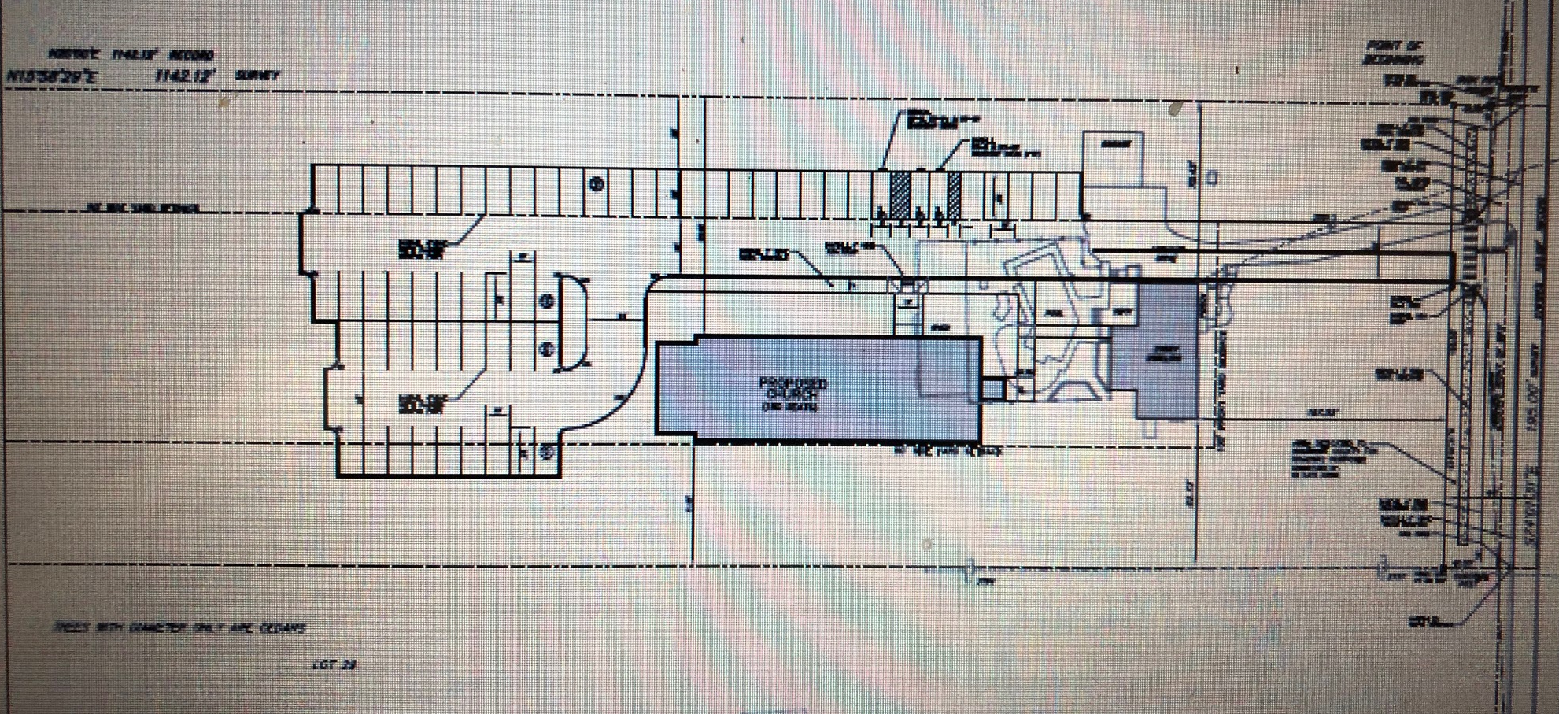
Site Plan for the church building and the existing house

Slide 3
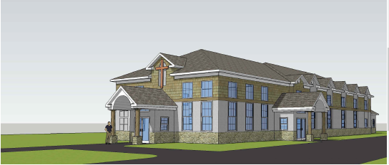
The Side View of Church from Parking Lot

Slide 4
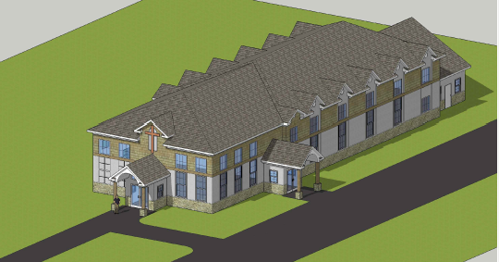
Birdview of church from left side

Slide 5
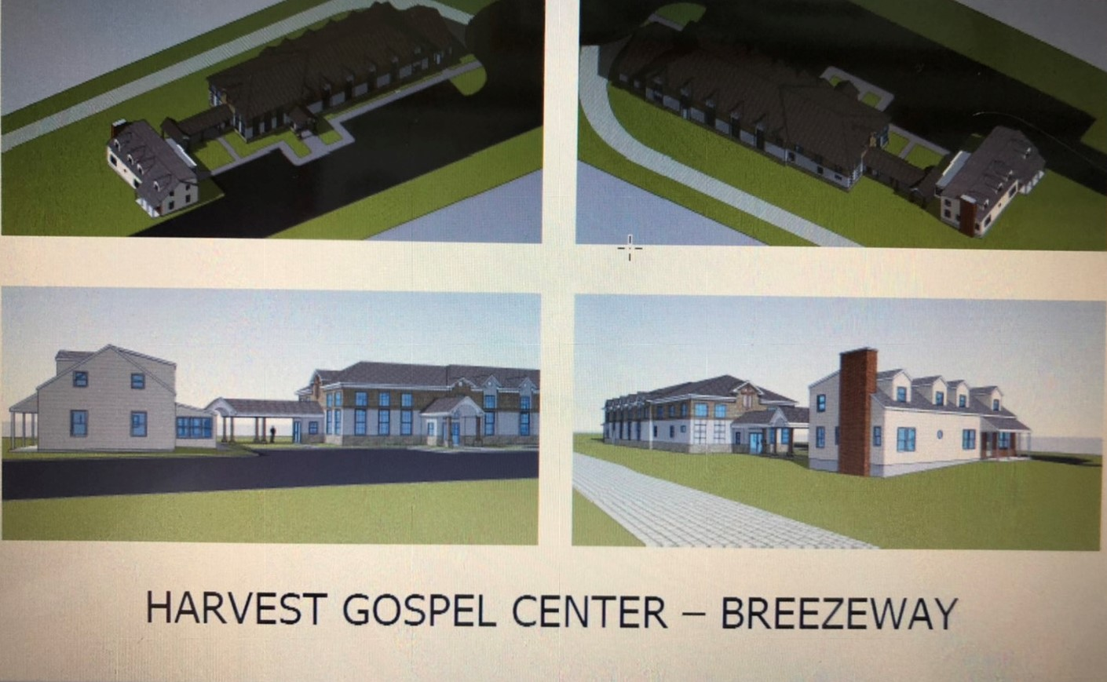
Breezeway connects
for the church building and the existing house

Slide 6
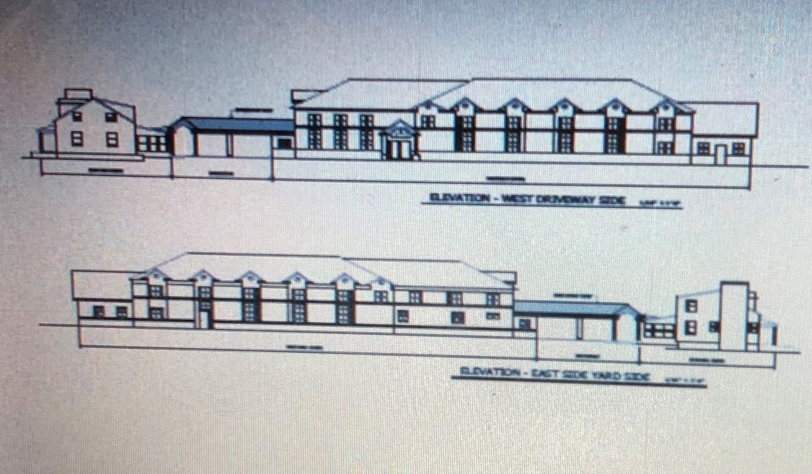
Side views of the walkway

Slide 7
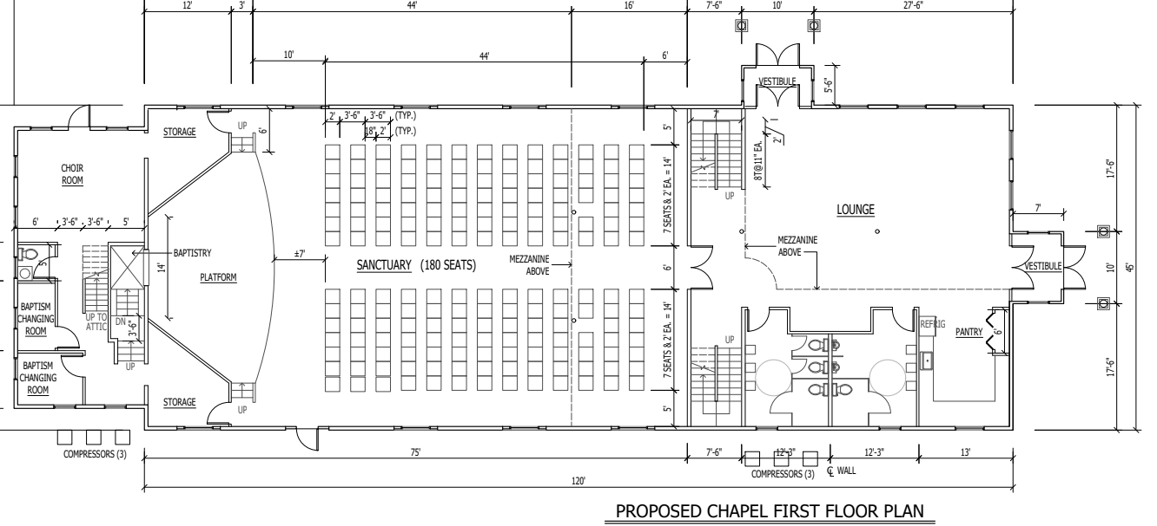
Inside the church building (I)

Slide 8
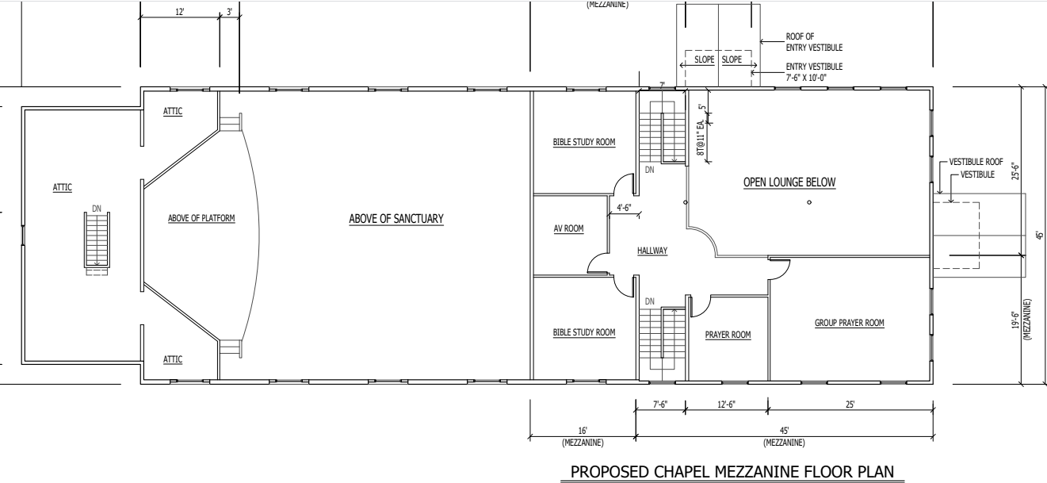
Inside the church building (II)

Slide 9
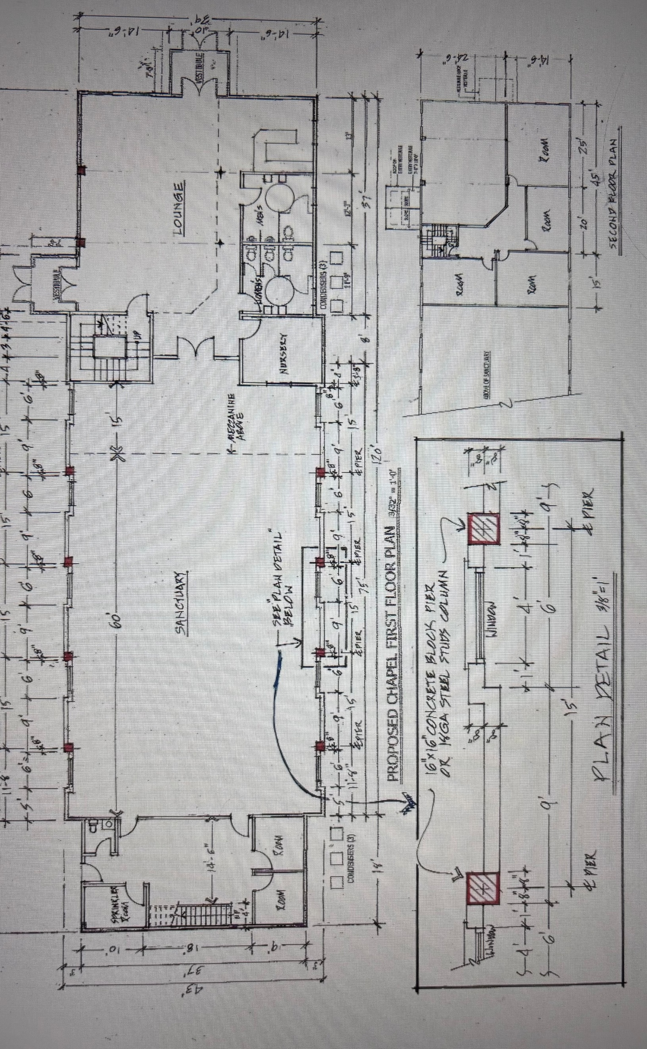
Inside the church building

Slide 10
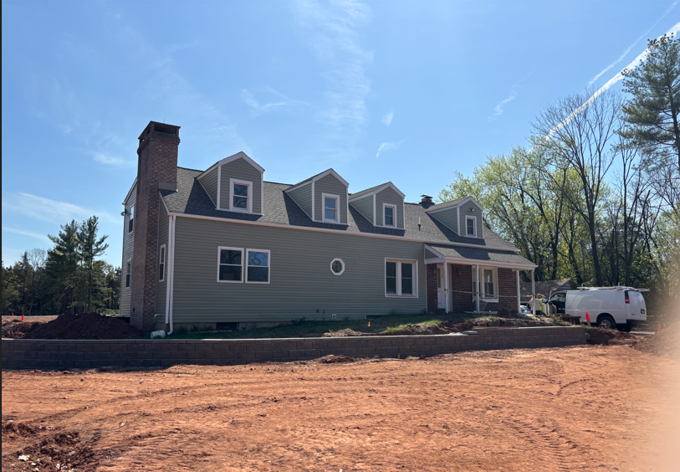
New Front Looking of remodeled house (1)

Slide 11
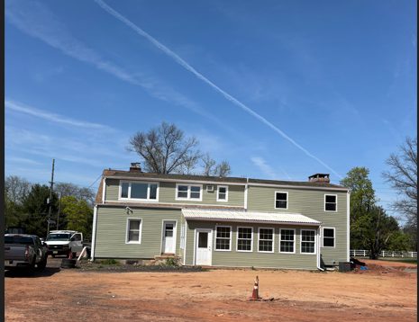
New Back Looking of remodeled house (2)

